Slide 1

New Predictors From Old
Reading: 3.4
exercises: NONE
Assigned: hw 9
Producer: dr. mario
img credit: alex riegert-waters

Slide 2
Motivation
The Set of Possible Predictors in a Model May Be Larger Than the Number of Variables in Our Data
We May Want to Consider Interactions (Example: Plant Growth)
We May Want to Consider Polynomial Terms to Capture Nonlinearity
We May Want to Create Metrics Off Our Variables
Ratios, Differences, Lags, etc.

Slide 3
Regression Model With Interaction
Model:
Interaction Variable is a Product of Two Other Variables
Interaction Variable Allows the Slope of Each of the Individual Variables to be Dependent on the Value of the Other Variable
$$Y=β_{0}+β_{1}X_{1}+β_{2}X_{2}+β_{3}X_{1}X_{2}+ε$$
$$Y=β_{0}+(β_{1}+β_{3}X_{2})X_{1}+β_{2}X_{2}+ε$$
$$Y=β_{0}+β_{1}X_{1}+{(β}_{2}+β_{3}X_{1})X_{2}+ε$$

Slide 4
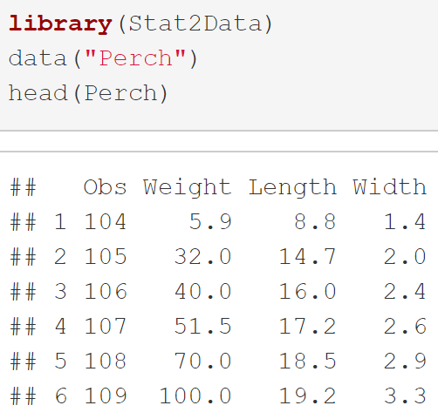
Example: Predicting Weight of Perch
Data Perch in Stat2Data Package
Response: Weight
Predictors: Length & Width
Interaction: Length X Width

Slide 5

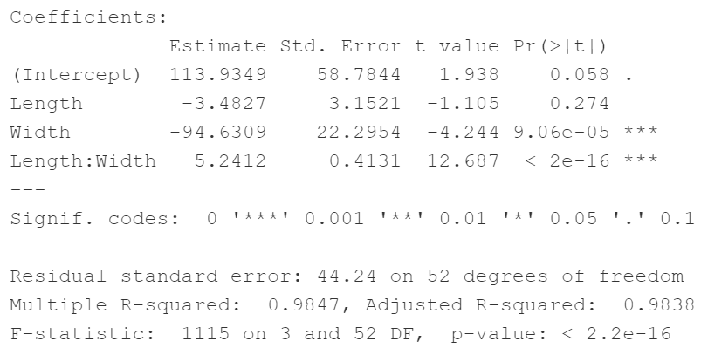
Example: Predicting Weight of Perch
Model:
Code:
Output:
$$Weight=β_{0}+β_{1}Length+β_{2}Width+β_{3}(Length×Width)+ε$$

Slide 6
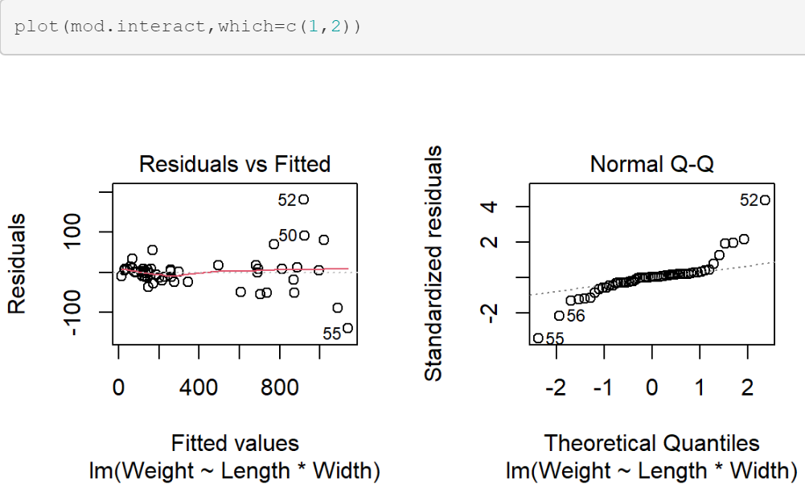
Example: Predicting Weight of Perch
Residuals:

Slide 7
Polynomial Regression Model
Model:
We Need to Choose the Degree of the Polynomial k
Polynomial Regression Models are More Difficult to Explain
This Model Can Be Used to Estimate Nonlinear Relationships but It is Still a Linear Regression Model
$$Y=β_{0}+β_{1}X^{1}+⋯+β_{k}X^{k}+ε$$

Slide 8
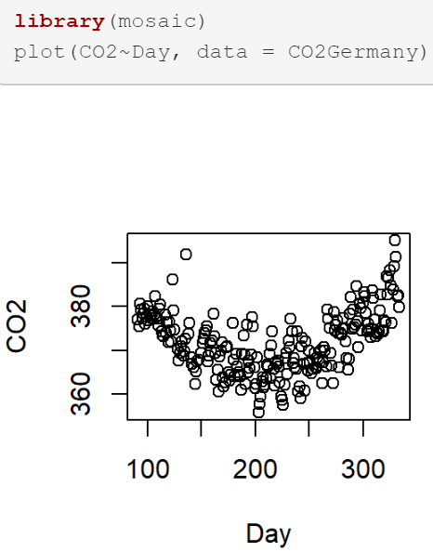
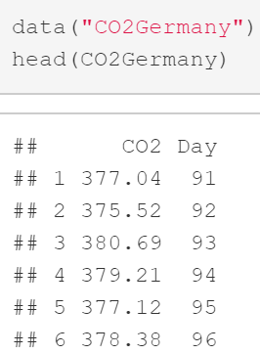
Example: Predicting CO2
Data CO2Germany in Stat2Data Package
Predict CO2 Based Off Day
Clear Relationship Seen

Slide 9

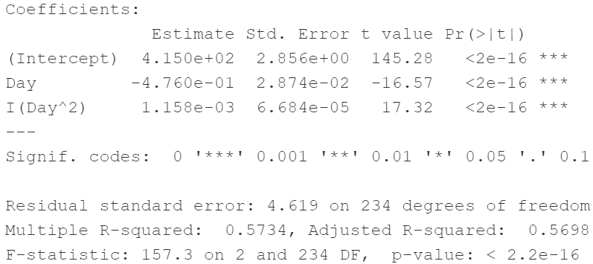

Example: Predicting CO2
Model:
Code:
Output:
$$CO2=β_{0}+β_{1}Day+β_{2}Day^{2}+ε$$

Slide 10
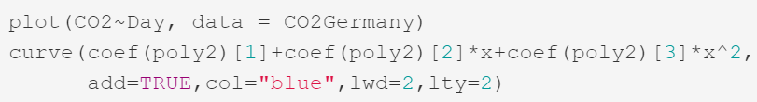
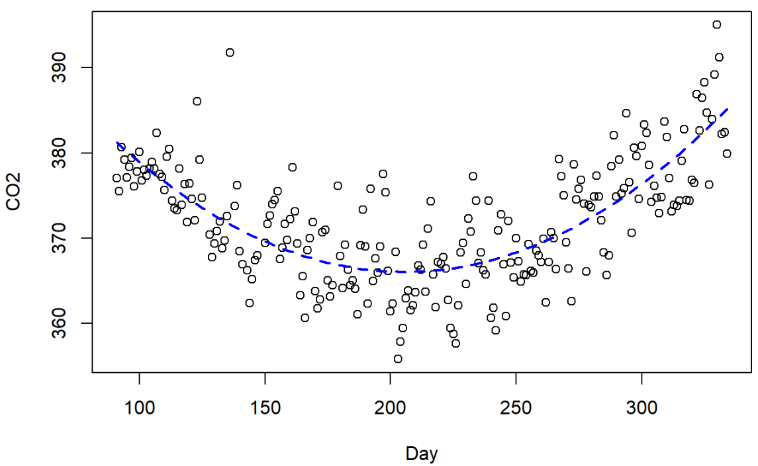
Example: Predicting CO2
Fitted Model:
Visualization of Model:
$$\hat{CO2}=414.97−0.476Day+0.00116Day^{2}+ε$$

Slide 11
Thank You
Make Reasonable Decisions

